Slide 1

END-TO-END DEPLOYMENT OF UBER PRICES PREDICTION MODEL

Slide 2
INDEX
PROBLEM STATEMENT
DATA SET
EDA
MODEL SELECTION
MODEL PREDICTION
CONCLUSION
DEPLOYMENT LINK

Slide 3
PROBLEM STATMENT
In recent years, a concept known as the ”sharing economy” has taken the market by storm, giving rise to a number of truly revolutionary businesses. While a number of companies have cashed in on this trend, the sharing economy’s undisputed king is Uber as a ride-sharing company that empowers anyone to start earning money with their vehicle and enables those needing a lift to quickly and affordable to find a ride. the amount of success Uber has been able to achieve in their short history is remarkable. Uber’s disruptive technology, explosive growth, and constant controversy make it one of the most fascinating companies to emerge over the past decade. the almost ten-year-old company soon grew to become the highest valued private start up company in the world.
Founder of Uber: Garrett Camp Travis Kalanick
Headquarters: San Francisco, California, United States

Slide 4
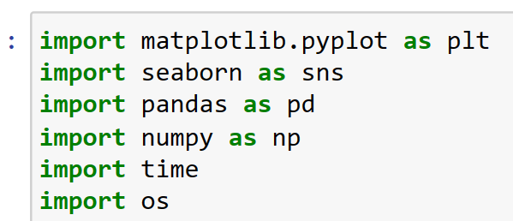
Uber dataset
UBER DATA HAS 52328835 ROWS.
AND 20 COLUMNS.
LIBRARIES IMPORTS

Slide 5
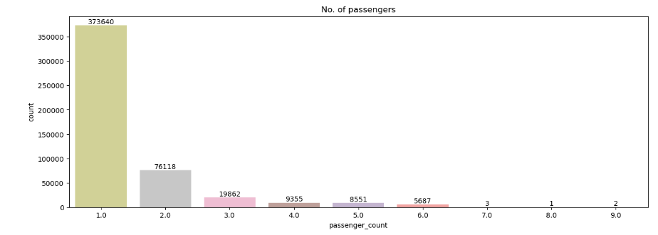
exploratory data analysis (EDA)
This graph shows which passengers travel the most frequently.

Slide 6
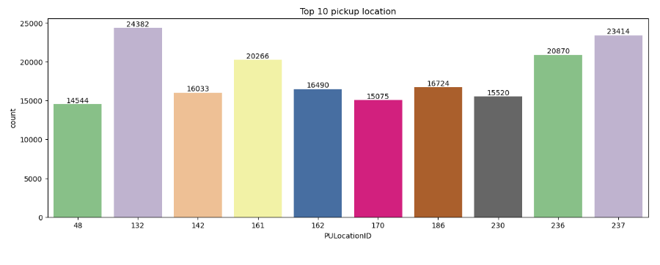
The most popular 10 pickup locations for passengers.

Slide 7
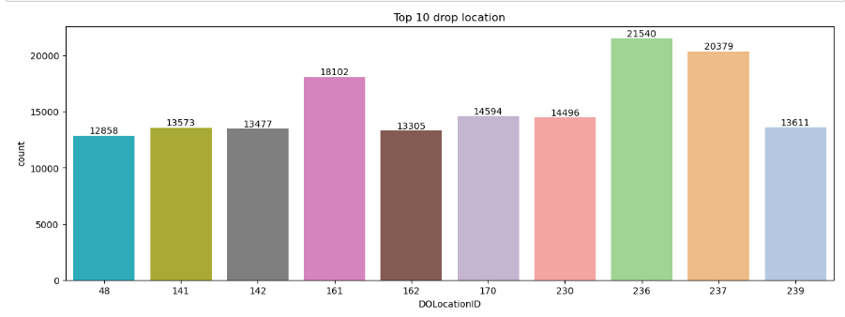
Top ten drop-off locations for passengers.

Slide 8
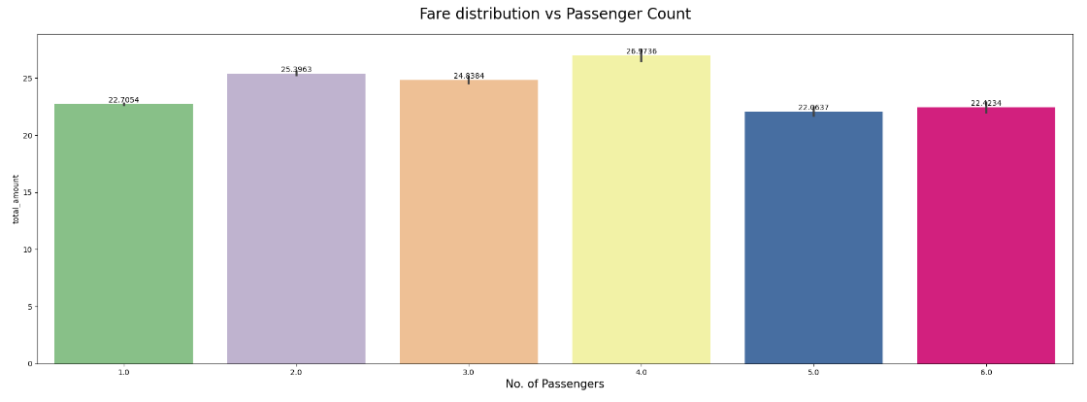
Distribution of fares according to passenger numbers.

Slide 9
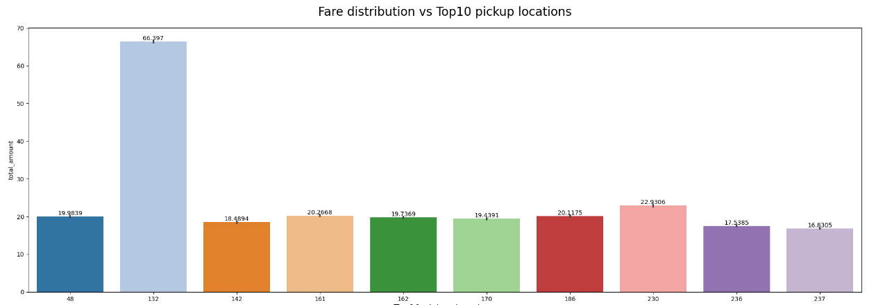
Fare distribution as per top 10 pick-up locations.

Slide 10
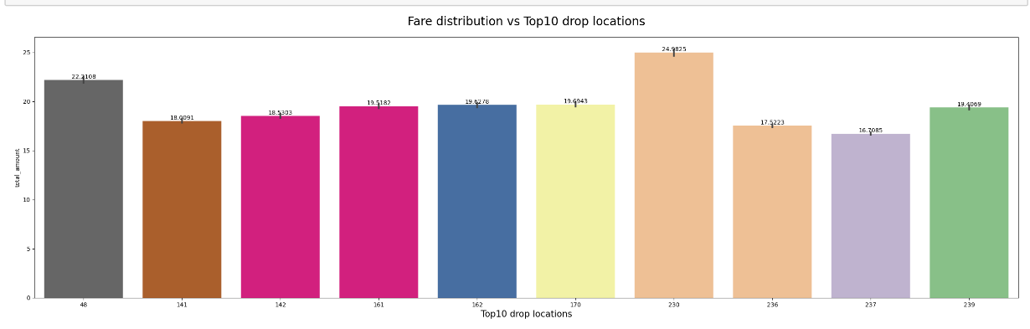
Fare distribution as per top 10 drop-off locations.

Slide 11
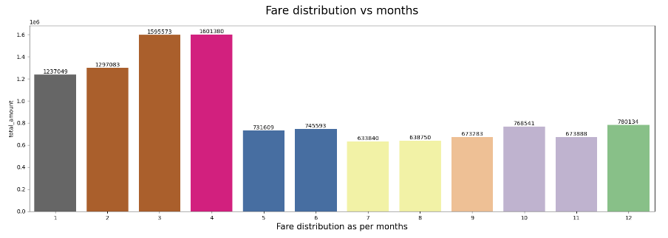
Fare distribution as per month.

Slide 12
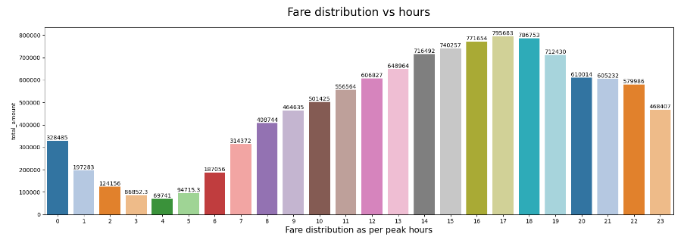
Fare distribution as per peak hours.

Slide 13
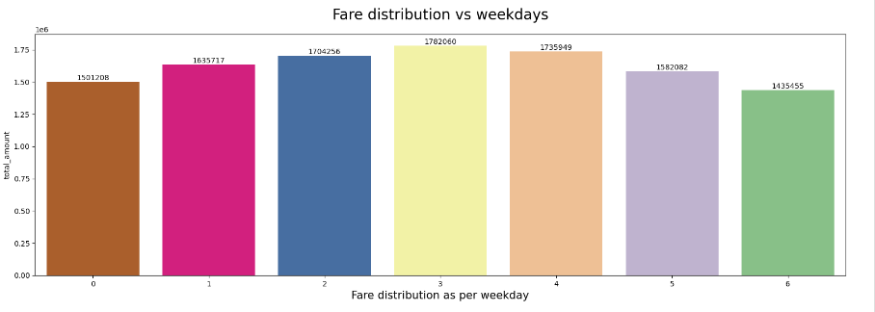
Distribution of fares according to weekdays.

Slide 14
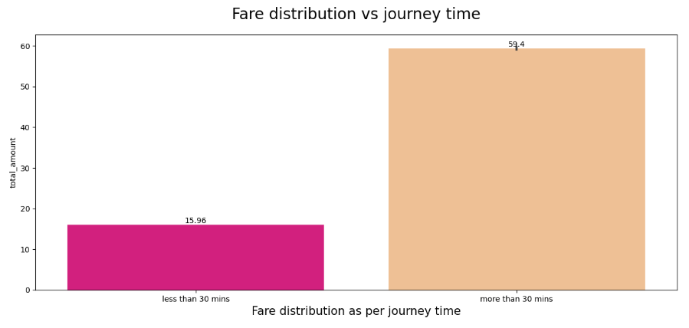
Fare distribution vs journey total time.

Slide 15
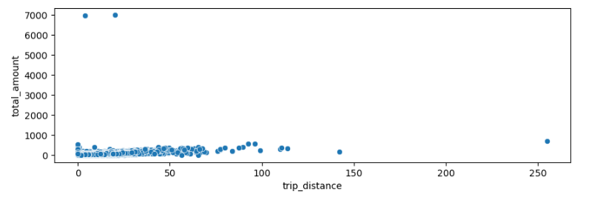
Trip distance and fare distribution.

Slide 16
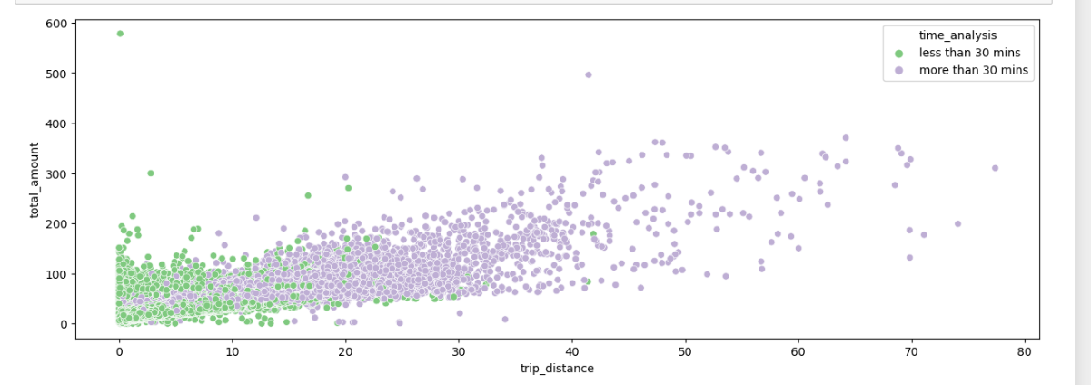
Fare distribution vs Time distribution.

Slide 17
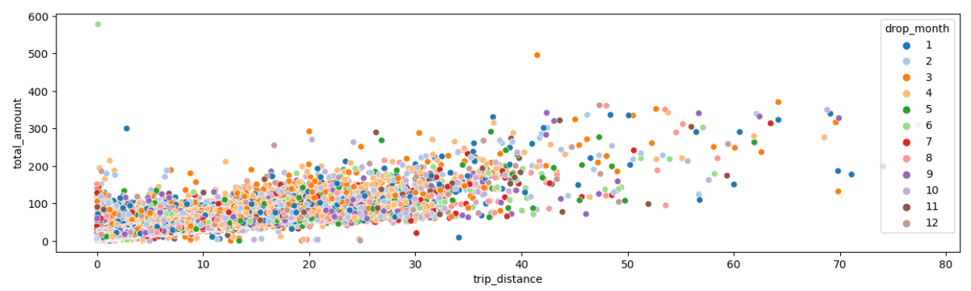
Fare distribution vs Drop month.

Slide 18
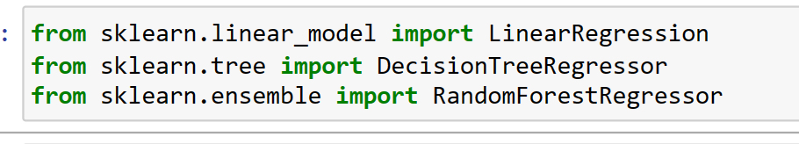
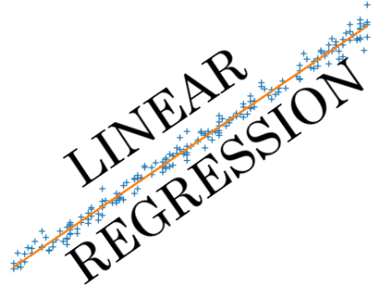
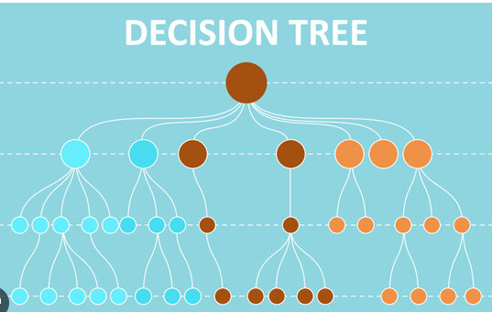
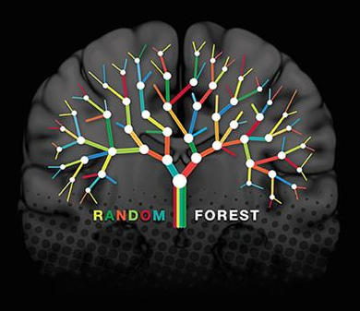
Models selections

Slide 19
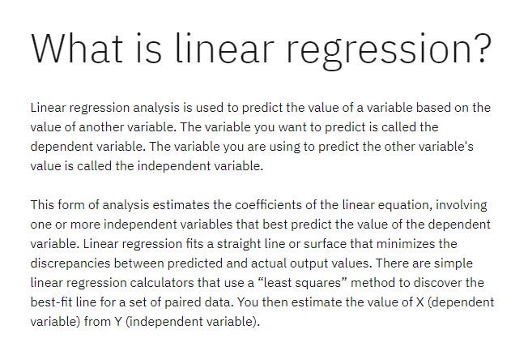
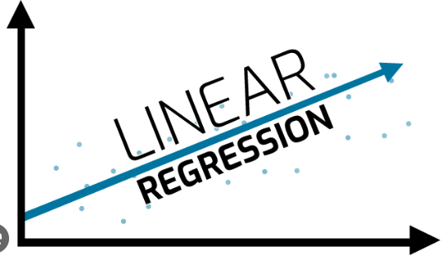

Slide 20
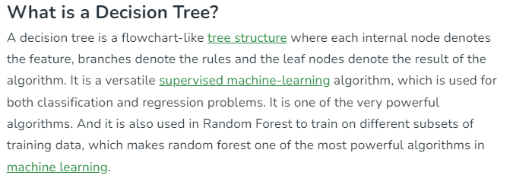
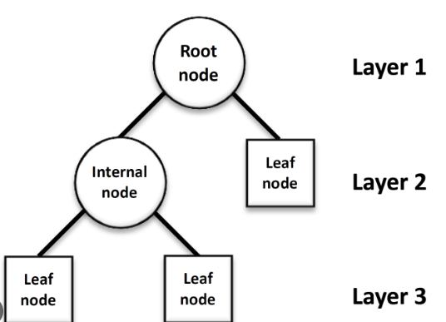

Slide 21
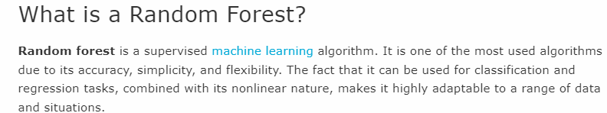
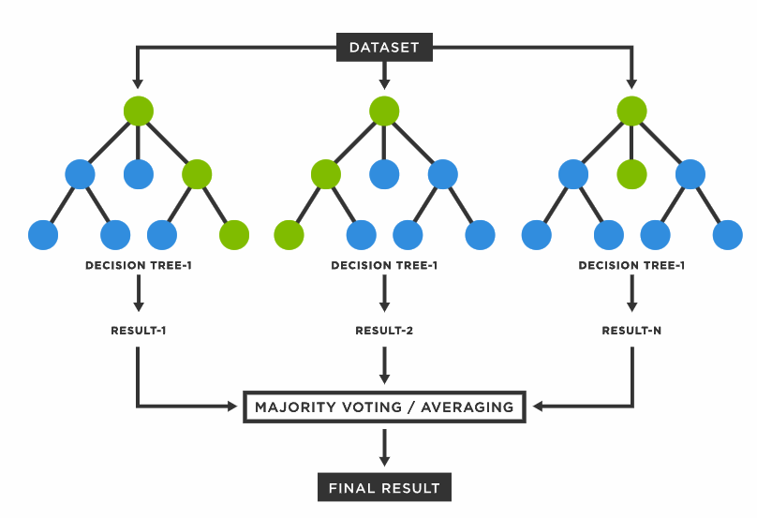

Slide 22
Conclusion
In conclusion, predicting Uber fares involves a complex interplay of various factors, passenger count, trip distance, pick hour, total mints, cash payment & credit card payment. Over time, advanced machine learning algorithms and data analytics have enabled Uber to develop increasingly accurate fare prediction models. These models not only benefit passengers by providing them with estimated costs for their rides but also assist drivers in making informed decisions about their earnings and routes.
However, it's important to note that while these prediction models have come a long way, they may not always be able to account for unexpected events such as sudden changes in traffic patterns or weather conditions. As technology continues to evolve, it's likely that these models will become even more sophisticated, leading to better fare prediction accuracy and overall improved user experience for both passengers and drivers.
As the ride-sharing industry and technology landscape continues to evolve, fare prediction will remain a crucial aspect of the overall user experience. Striking a balance between accurate predictions, flexibility in pricing, and responding to real-time conditions will be key for platforms like Uber to provide reliable and cost-effective transportation solutions to their customers.

Slide 23
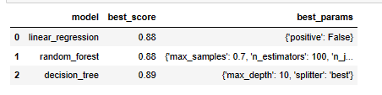
Model PREDICTION

Slide 24
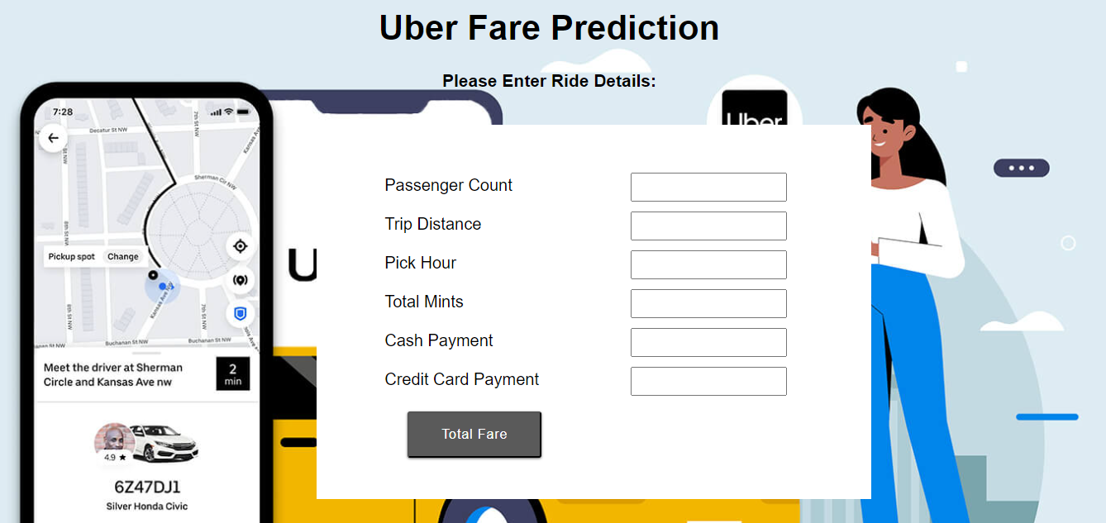

Slide 25
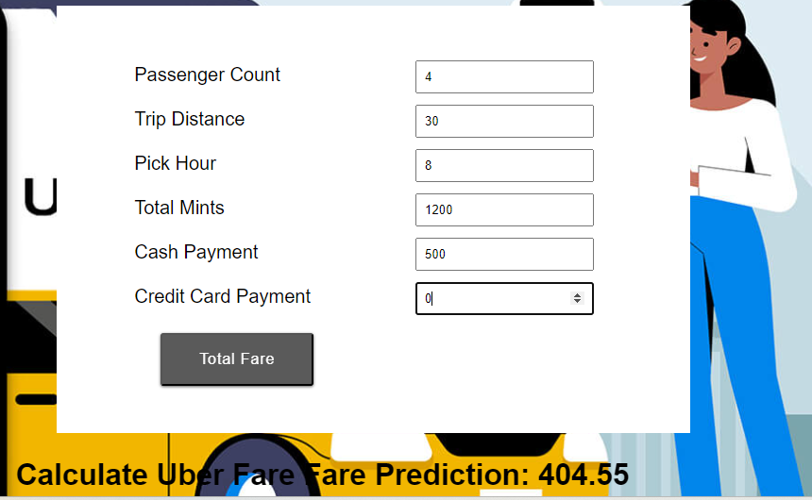
DEPLOY LINK
https://uber-fare-prediction.onrender.com

Slide 26
THANK YOU

